Slide 1
Sentimental Analysis on IMDB Movie Reviews
Mod 9 Presentation
Max (???) Lim Zheng Wei

Slide 2
Intro
Sentiment analysis refers to the use of natural language processing, text analysis, computational linguistics, and biometrics to systematically identify, extract, quantify, and study affective states and subjective information
Applications include
Reviews, survey responses
Online and social media, and healthcare materials applications
Customer service

Slide 3
Objective & Scope
Do sentiment analysis engine on IMDB reviews
We shall use our good friend to help us
Dataset Preparation
Feature Engineering
Model Training
Improve Model

Slide 4
Data Preparation
Import relevant libraries & data
Do some simple EDA
Clean text
Common word removal
Rare word removal
Word Cloud
Modelling
Set feature labels

Slide 5
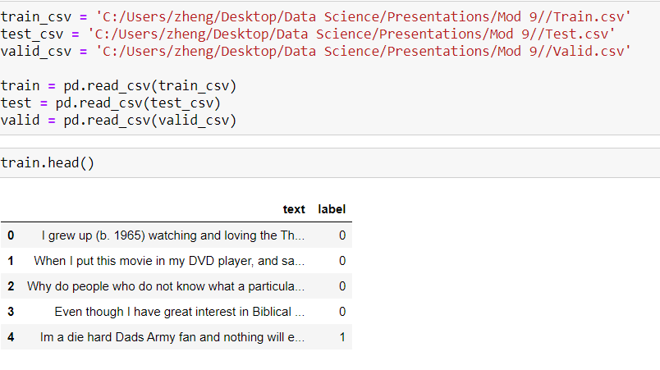
Import Data

Slide 6
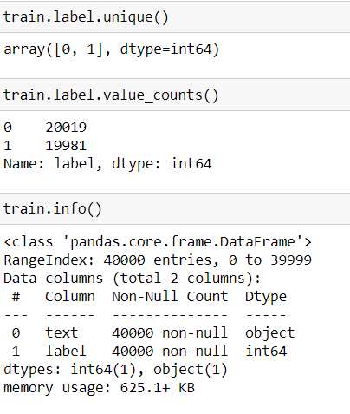
CSI Time…
40000 entries
0 null value
Positive (1) or negative (0) value
pretty equally distributed
Too many examples for our
computation capacity
Split the dataset and reduce it.

Slide 7
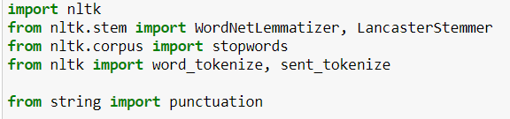

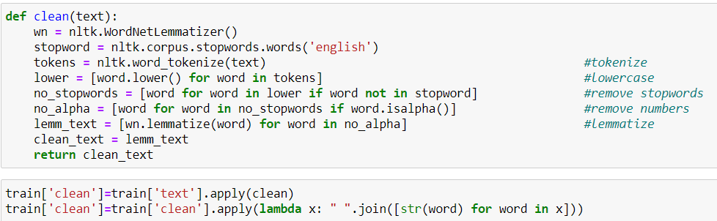
CNY Cleaning

Slide 8
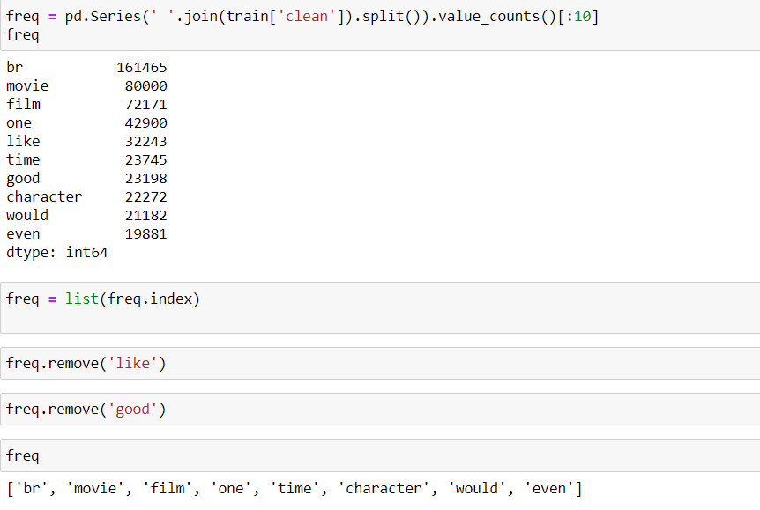
Common Word Removal
Previously, we just removed commonly occurring words in a general sense.
Can also remove commonly occurring words from our text data
Check the 10 most frequently occurring words in our text data then take call to remove or retain.

Slide 9
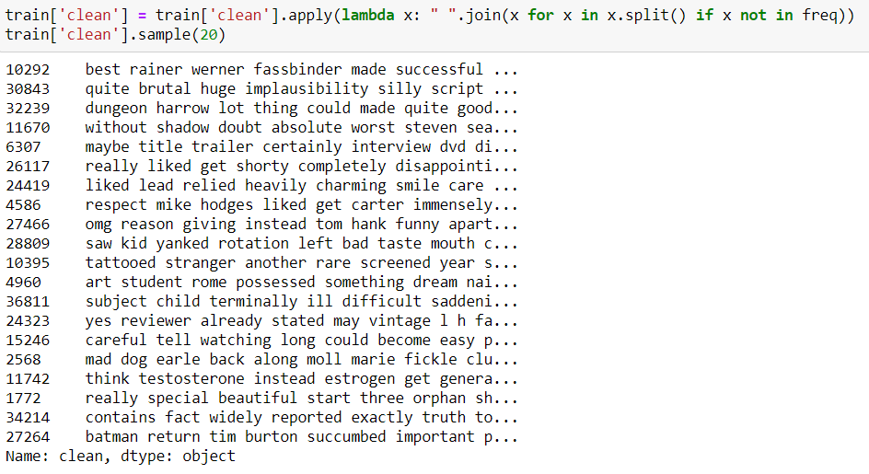

Slide 10
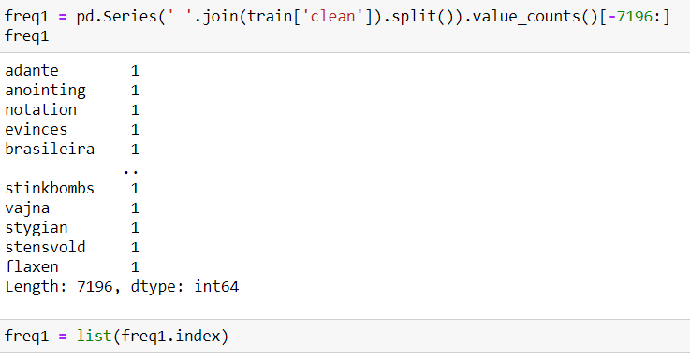
Rare Word Removal
Remove rarely occurring words from the text
Because they’re so rare, the association between them and other words is dominated by noise.
Can replace rare words with a more general form and then this will have higher counts

Slide 11
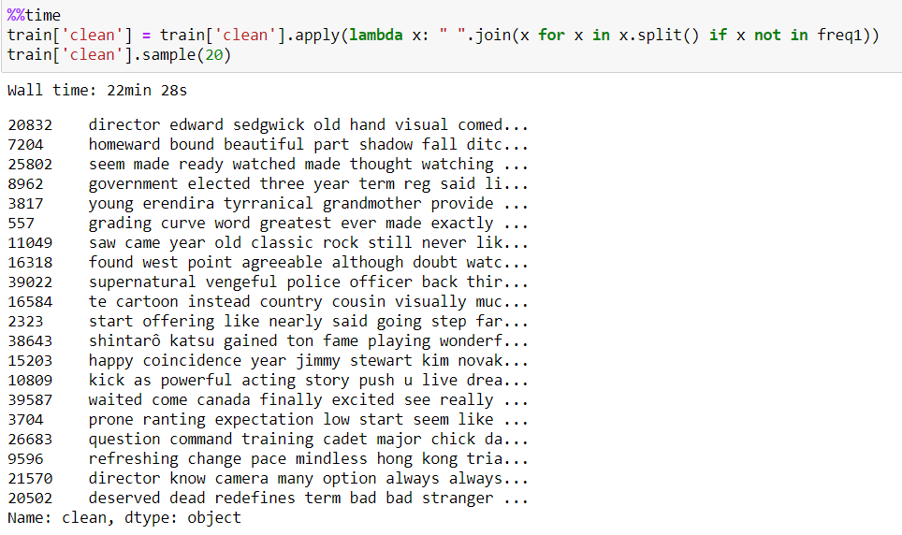

Slide 12
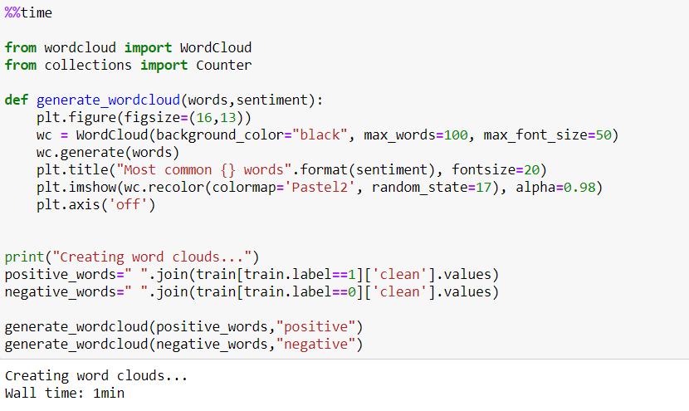
Word Cloud

Slide 13
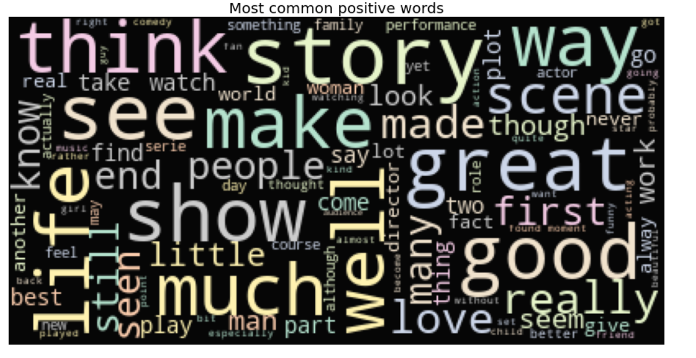

Slide 14
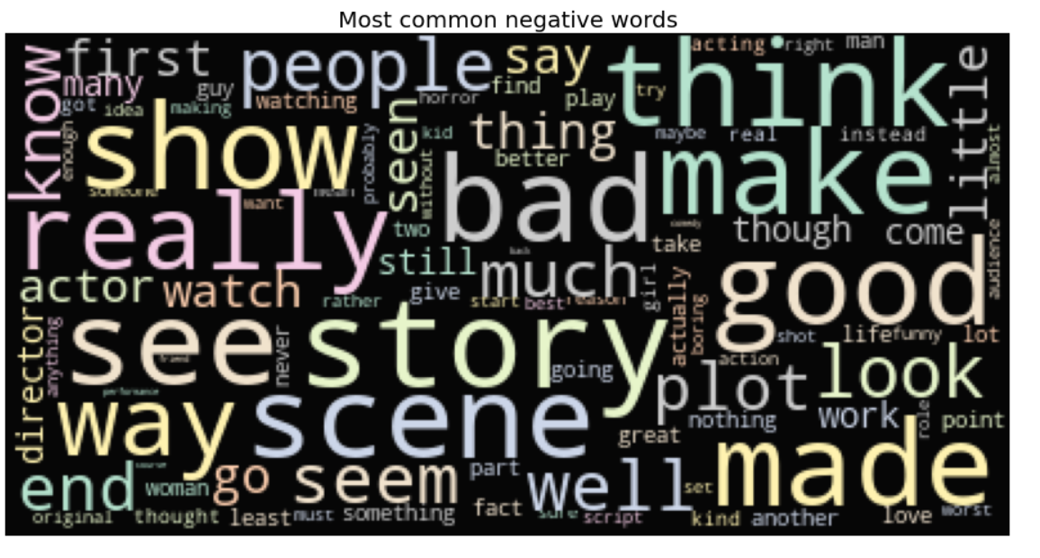

Slide 15
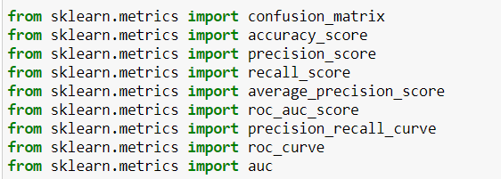
Modelling

Slide 16
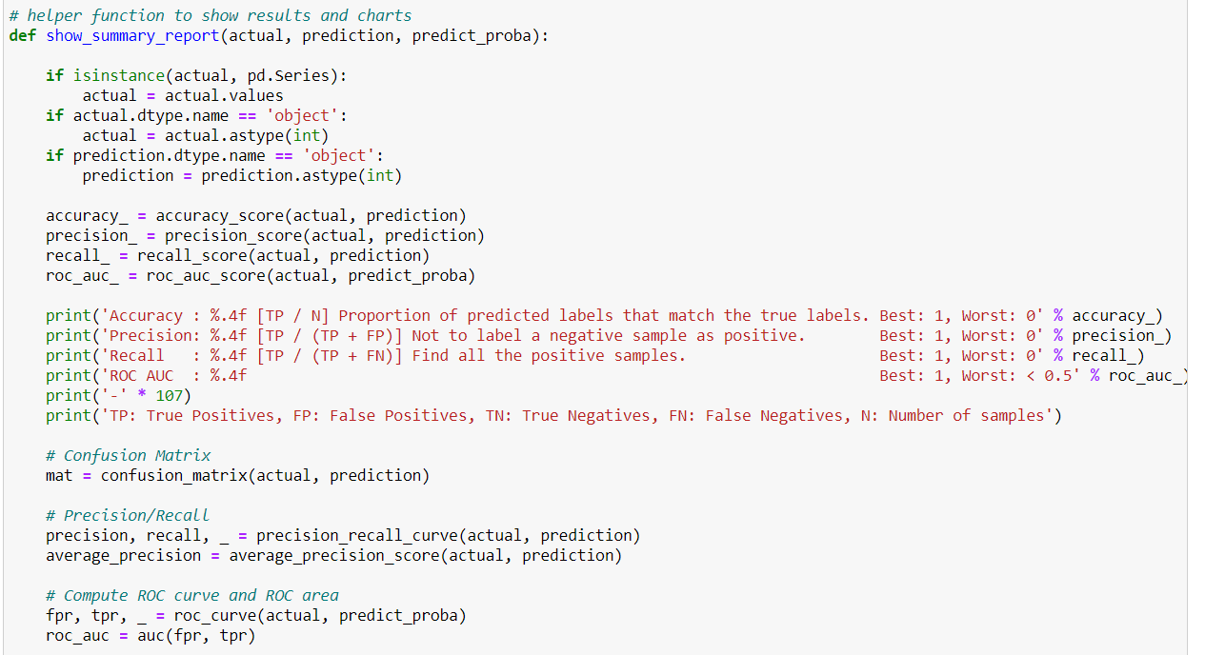

Slide 17
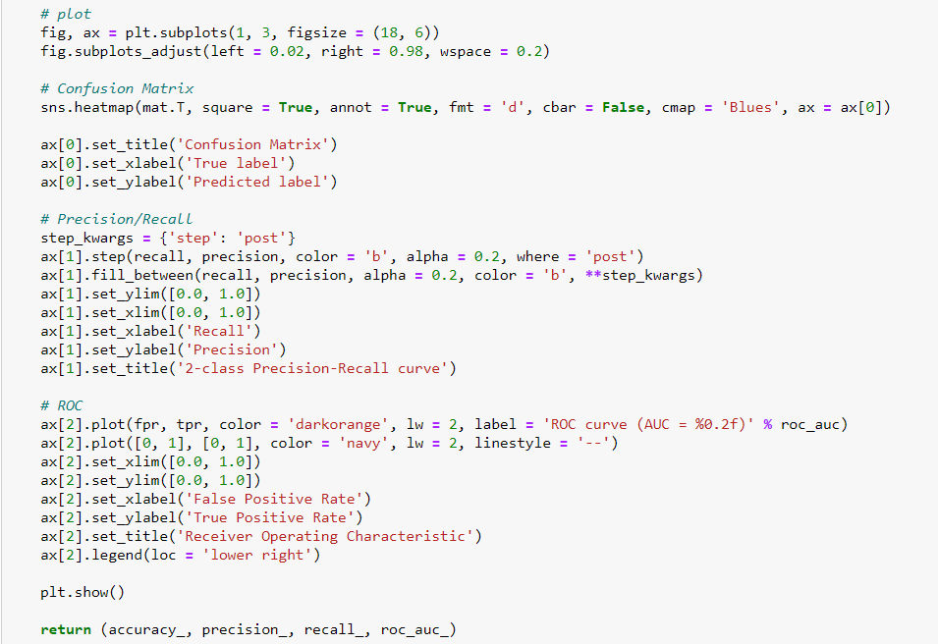

Slide 18
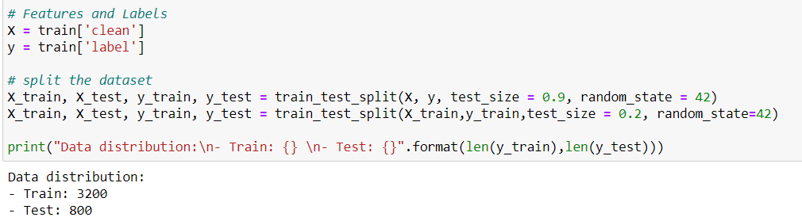
Set Feature Labels

Slide 19
2. Feature Engineering
A. CountVectorizer()
B. TF-IDF Vectorizer()
Word Level
N-Gram Level
Character Level
C. Topic Model

Slide 20
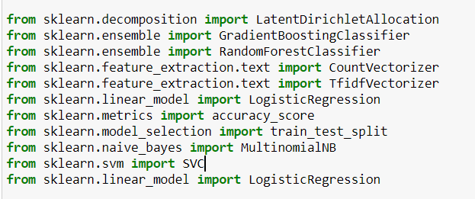

Slide 21
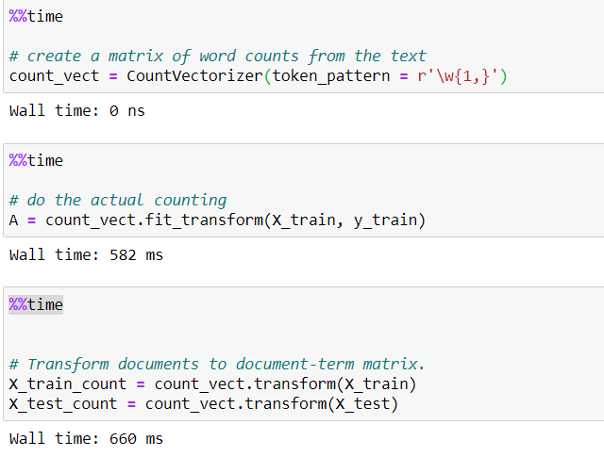
2A CountVectorizer

Slide 22
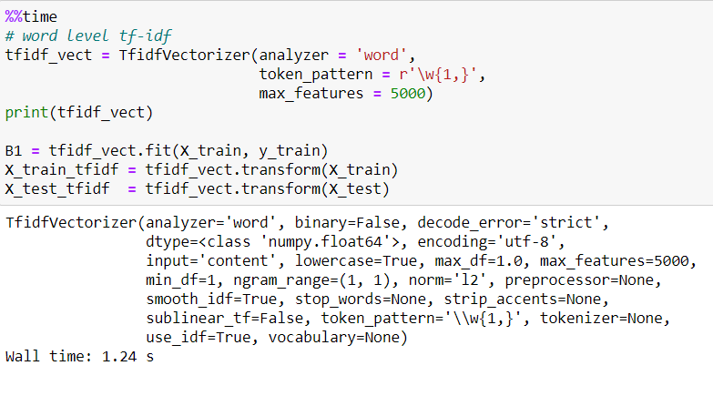
2B.1 TF-IDF Vectorizer

Slide 23
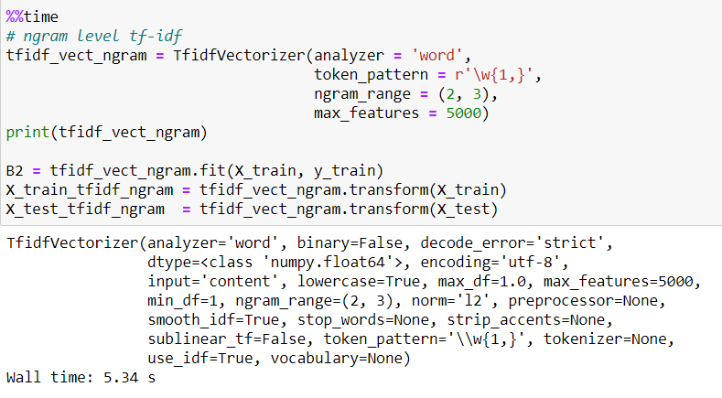
2B.2 TF-IDF Vectorizer N-Gram

Slide 24
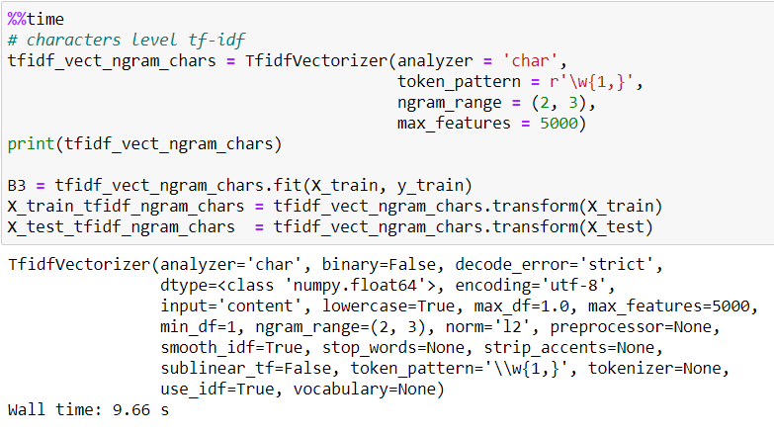
2B.3 TF-IDF Vectorizer N-Gram Char

Slide 25
Latent Dirichlet Allocation(LDA)
A recurring theme in NLP is to understand large corpus of texts through topics extraction
Understanding key topics will always come in handy
Unsupervised machine-learning model that takes documents as input and finds topics as output
Also shows in what percentage each document talks about each topic

Slide 26
There are 3 main parameters of the model:
the number of topics
the number of words per topic
the number of topics per document

Slide 27
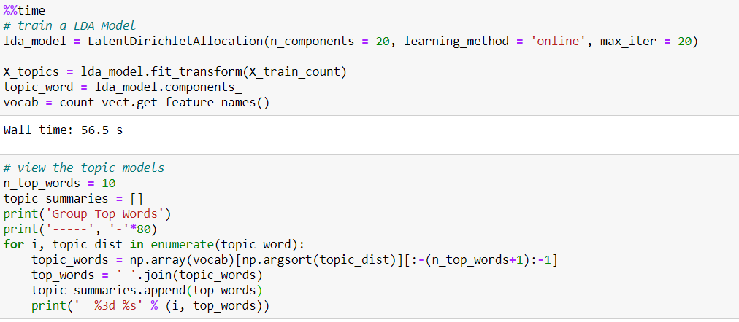
2C
Number of topics
Number of words per topic

Slide 28
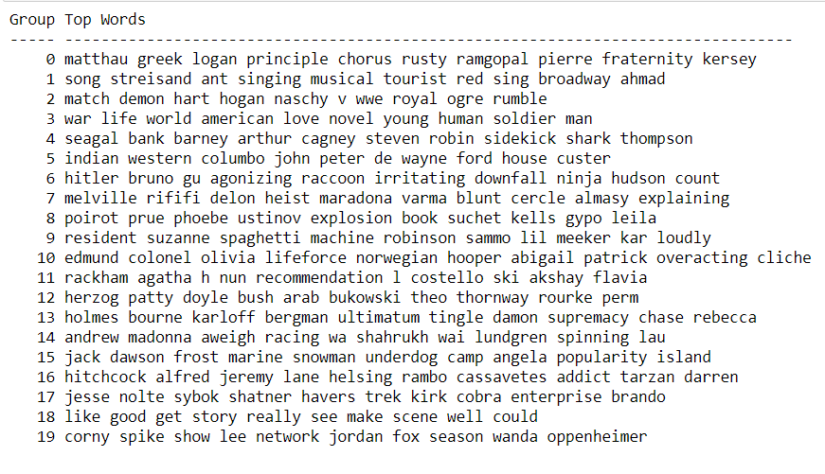

Slide 29
3. Text Classification
Naïve Bayes
Linear Classifier
Support Vector Machine
Bagging Models
Boosting Models

Slide 30
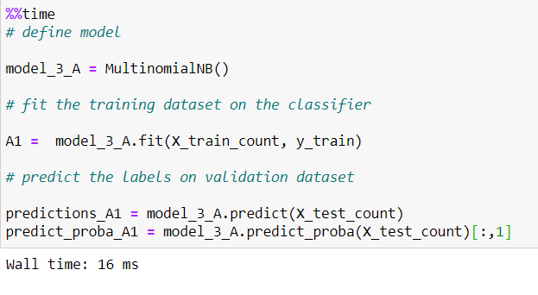
3A.1 Naïve Bayes

Slide 31
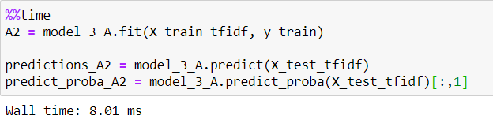
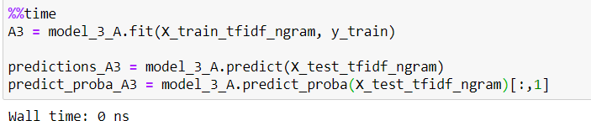
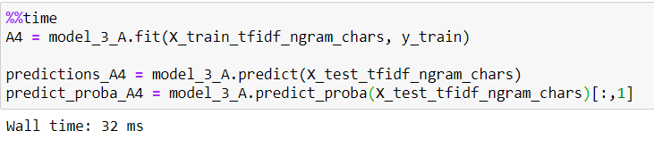
3A.2,3,4

Slide 32
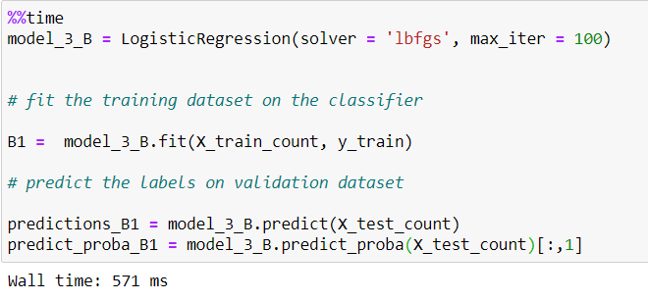
3B Linear Classifier

Slide 33
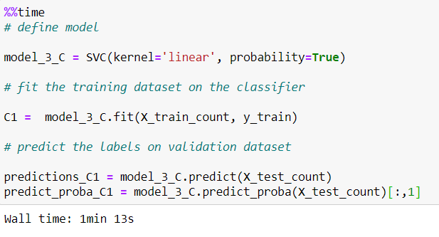
3C Support Vector Machine

Slide 34
3D Bagging Model
Goal: Reduce the variance of a decision tree classifier
Objective: Create several subsets of data from training sample chosen randomly with replacement. Each collection of subset data is used to train their decision trees. As a result, we get an ensemble of different models. Average of all the predictions from different trees are used which is more robust than a single decision tree classifier.

Slide 35
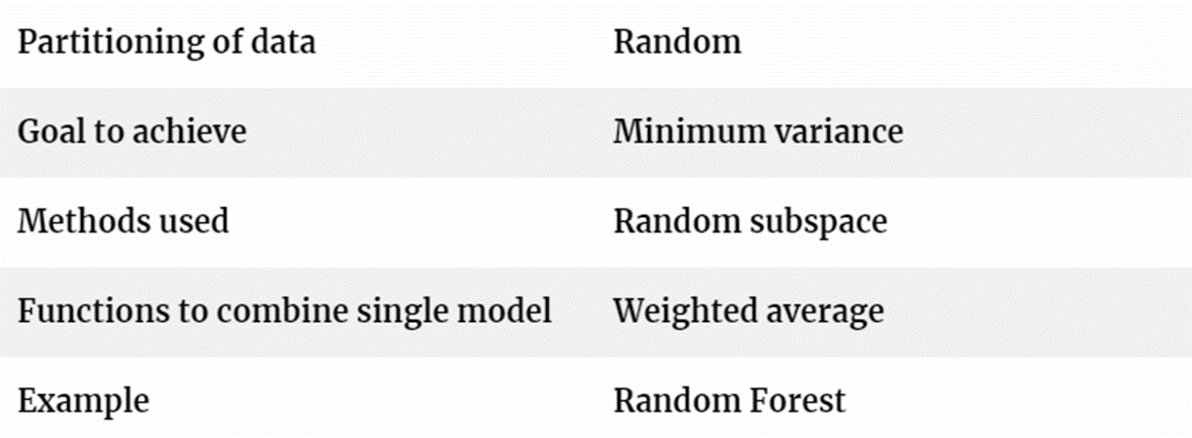
Analogy: Sort out items in a house

Slide 36
Advantages:
Reduces over-fitting of the model.
Handles higher dimensionality data very well.
Maintains accuracy for missing data.
Disadvantages:
Since final prediction is based on the mean predictions from subset trees, it won’t give precise values for the classification and regression model.

Slide 37
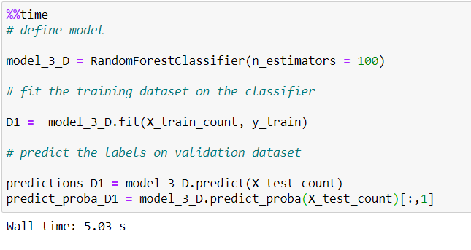
3D

Slide 38
3E Boosting Model
Create a collection of predictors
Learners are learned sequentially with early learners fitting simple models to the data and then analysing data for errors. Consecutive trees (random sample) are fit and at every step
Goal : Improve the accuracy from the prior tree. When an input is misclassified by a hypothesis, its weight is increased so that next hypothesis is more likely to classify it correctly. This process converts weak learners into better performing model.

Slide 39
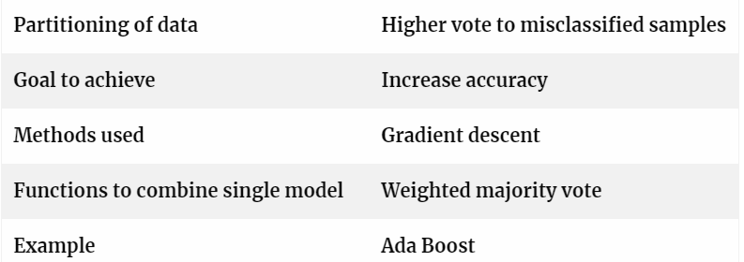
Analogy: Diagnostics Test, Streaming Test

Slide 40
Advantages:
Supports different loss function (we have used ‘binary:logistic’ for this example).
Works well with interactions.
Disadvantages:
Prone to over-fitting.
Requires careful tuning of different hyper-parameters.

Slide 41
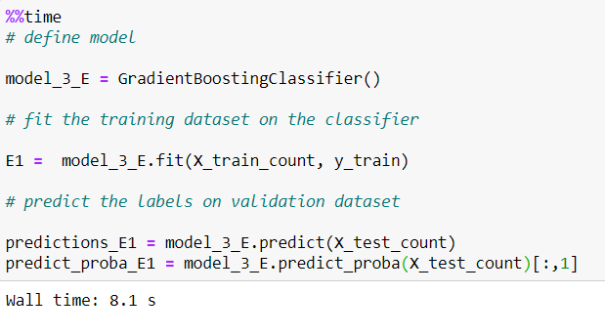

Slide 42
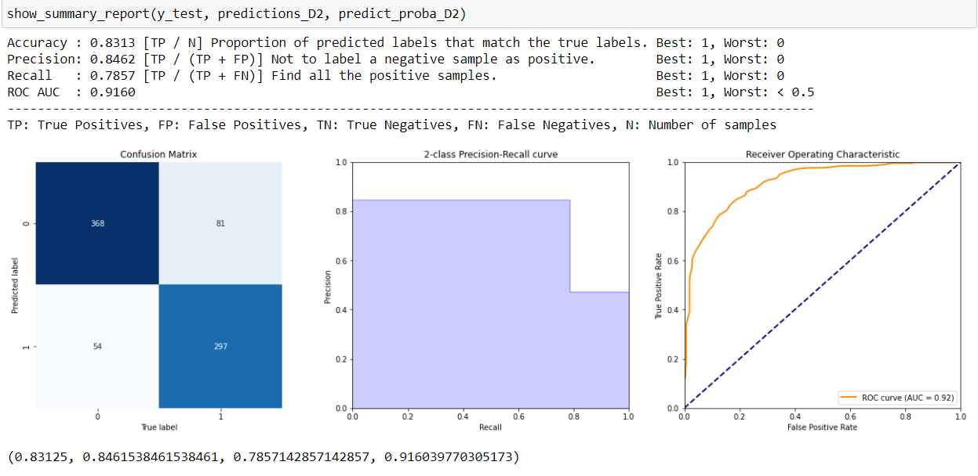
4. Summary Report

Slide 43
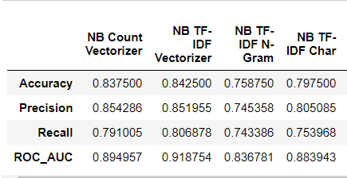
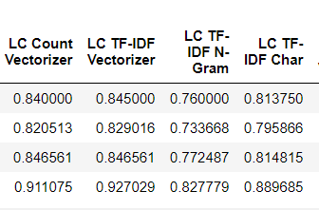
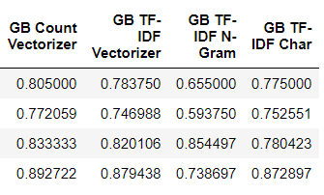
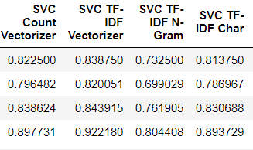
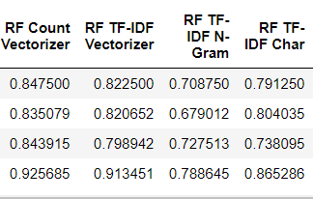

Slide 44
Conclusion
Every model is pretty solid
Pretty accurate
Best model is LC TF-IDF Vectorizer

Slide 45
References
https://en.wikipedia.org/wiki/Sentiment_analysis
https://www.kdnuggets.com/2019/09/overview-topics-extraction-python-latent-dirichlet-allocation.html
https://analyticsindiamag.com/primer-ensemble-learning-bagging-boosting/#:~:text=Bagging%20is%20a%20way%20to,based%20on%20the%20last%20classification.

